Slide 1
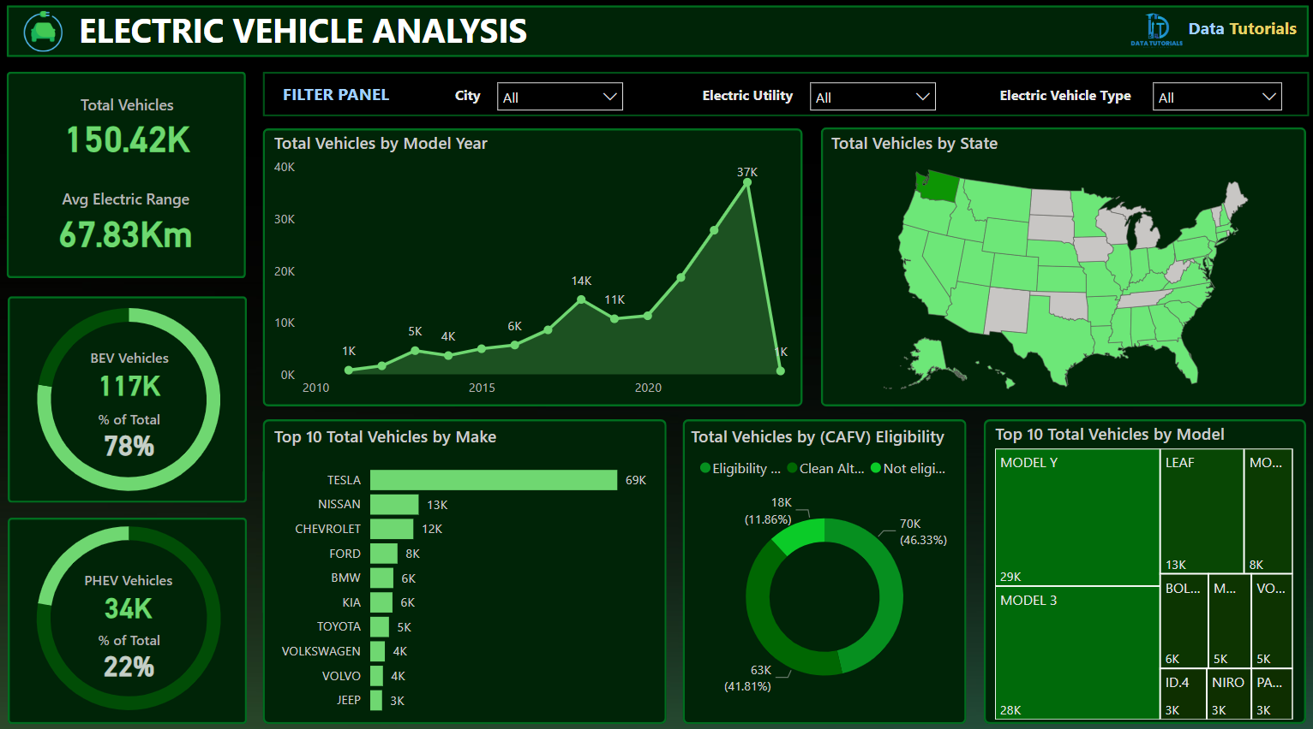
INTRODUCTION
The electric vehicle (EV) market has experienced tremendous growth over the past decade, driven by the global shift towards sustainable energy solutions and the increasing need to reduce carbon emissions.
As governments and organizations worldwide implement policies promoting clean energy, electric vehicles have emerged as a key solution for reducing the environmental impact of the transportation sector.
In 2024, the global population of electric vehicles continues to grow at an unprecedented rate, with advancements in technology, infrastructure development, and policy frameworks playing a critical role in accelerating this trend.
This project analyzes the Electric Vehicle Population Data for 2024, providing insights into the distribution, adoption rates, and trends shaping the EV industry.
The dataset captures important metrics, such as the total number of EVs in operation, regional adoption patterns, and the types of registered electric vehicles, offering a comprehensive overview of the current state of the EV market.

Slide 2
ABOUT
The Electric Vehicle Population Data 2024 dataset offers a detailed view of the electric vehicle landscape by capturing key characteristics at both global levels. This dataset includes various columns that provide granular information about the distribution and specifications of electric vehicles. Below is a brief description of the columns in the dataset:
Country: The country where the electric vehicle is registered or in operation.
City: The specific city where the electric vehicle is located or registered.
State: The state or region within the country where the vehicle is registered.
Postal Code: The postal or ZIP code of the area corresponding to the vehicle’s registration or location.
Model Year: The year in which the electric vehicle model was manufactured, indicating its generation and technology level.
Make: The brand or manufacturer of the electric vehicle (e.g., Tesla, Nissan, BMW).
Model: The specific model of the electric vehicle (e.g., Tesla Model 3, Nissan Leaf).
CAFV: Clean Alternative Fuel Vehicle designation, which may indicate whether the vehicle qualifies for certain environmental or clean energy incentives.
Electric Range: The maximum distance the electric vehicle can travel on a full charge, expressed in miles or kilometers, providing insight into the vehicle’s battery capacity and efficiency.

Slide 3
PROBLEM STATEMENT
KPI’S Requirement
Total Vehicles:
Understand the overall landscape of electric vehicles, encompassing both BEVs and PHEVs, to assess the market's size and growth.
2. Average Electric Range:
Determine the average electric range of the electric vehicles in the dataset to gauge the technological advancements and efficiency of the EVs.
3. Total BEV Vehicles and % of Total BEV Vehicles:
Identify and analyze the total number of Battery Electric Vehicles (BEVs) in the dataset.
Calculate the percentage of BEVs relative to the total number of electric vehicles, providing insights into the dominance of fully electric models.
4. Total PHEV Vehicles and % of Total PHEV Vehicles:
Identify and analyze the total number of Plug-in Hybrid Electric Vehicles (PHEVs) in the dataset.
Calculate the percentage of PHEVs relative to the total number of electric vehicles, offering insights into the market share of plug-in hybrid models.

Slide 4
PROBLEM STATEMENT
Charts Requirement
Total Vehicles by Model Year (From 2010 Onwards):
Visualization: Line/ Area Chart
Description: This chart will illustrate the distribution of electric vehicles over the years, starting from 2010, providing insights into the growth pattern and adoption trends.
2. Total Vehicles by State:
Visualization: Map Chart
Description: This chart will showcase the geographical distribution of electric vehicles across different states, allowing for the identification of regions with higher adoption rates.
3. Top 10 Total Vehicles by Make:
Visualization: Bar Chart
Description: Highlight the top 10 electric vehicle manufacturers based on the total number of vehicles, providing insights into the market dominance of specific brands.
4. Total Vehicles by CAFV Eligibility:
Visualization: Pie Chart or Donut Chart
Description: Illustrate the proportion of electric vehicles that are eligible for Clean Alternative Fuel Vehicle (CAFV) incentives, aiding in understanding the impact of incentives on vehicle adoption.
5. Top 10 Total Vehicles by Model:
Visualization: Tree map
Description: Highlight the top 10 electric vehicle models based on the total number of vehicles, offering insights into consumer preferences and popular models in the market.

